Slide 1
Activity 4- Designing the front wing.

Slide 2
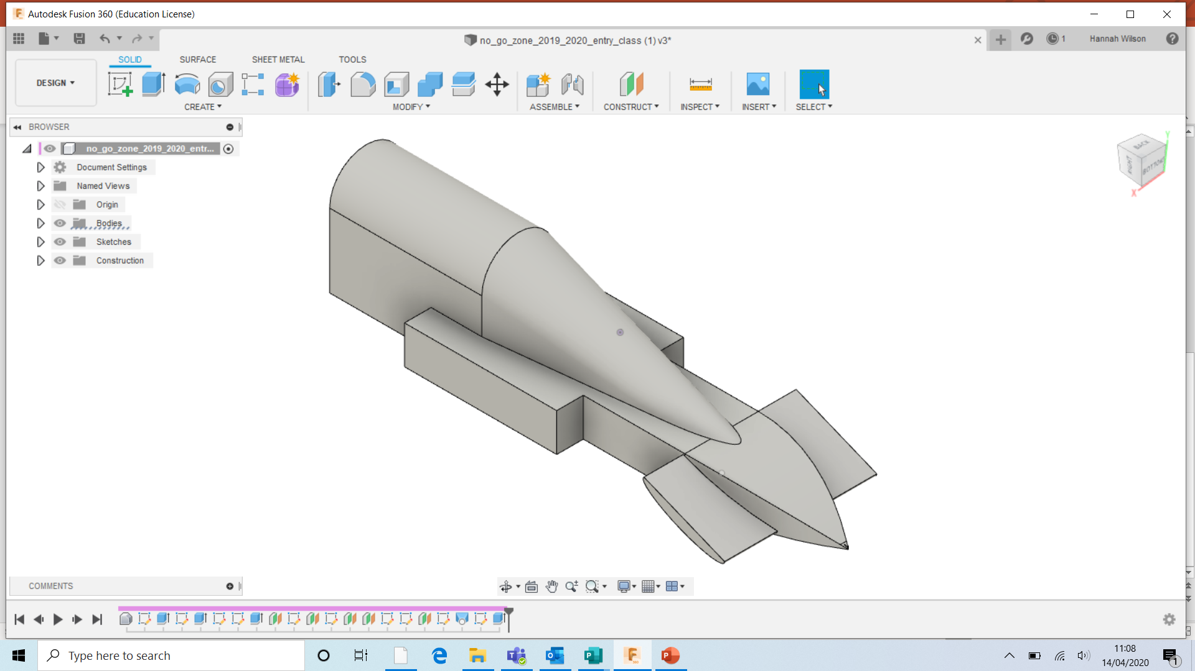
You are going to create the front wings on your car.
There will be different shaped wings throughout this guide.

Slide 3
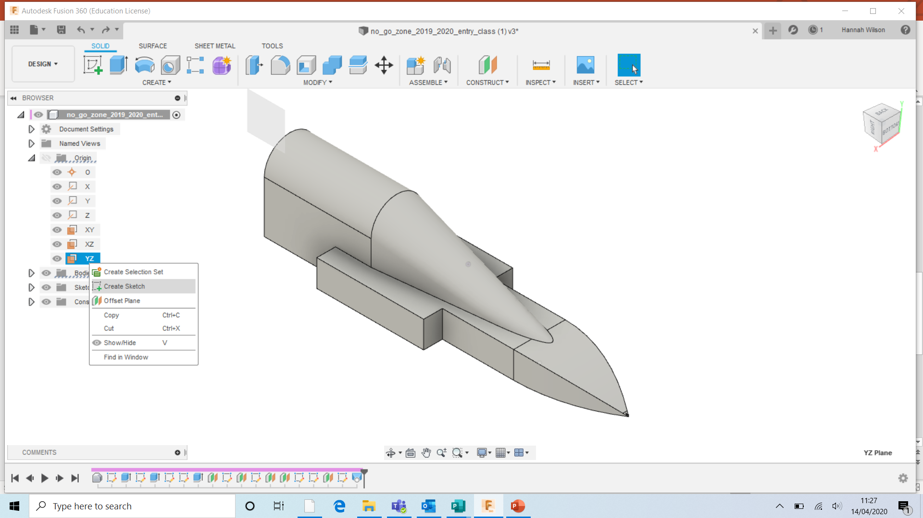
Origin- Click the arrow next to origin.
Right click YZ and select ‘Create Sketch’
TIP
Ensure the plane is in the middle of the car.

Slide 4
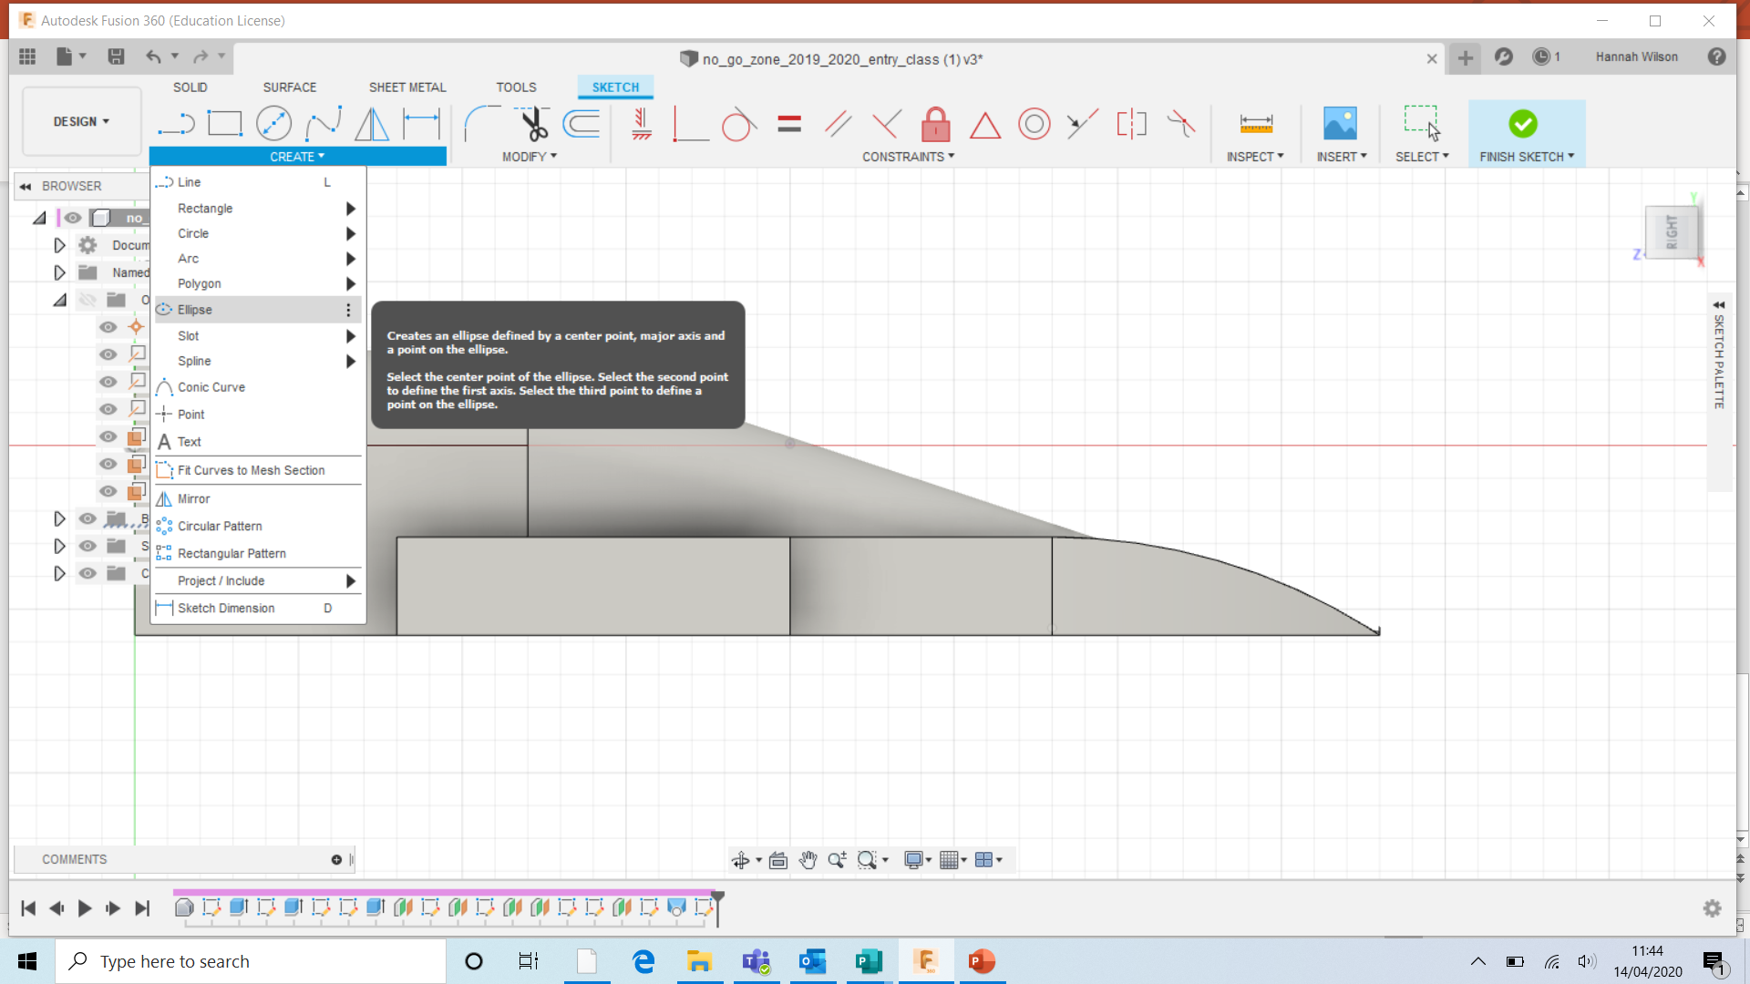
Ensure you can view the side the car. Use the cube to rotate.
Click ‘CREATE’
Select ‘Ellipse’

Slide 5
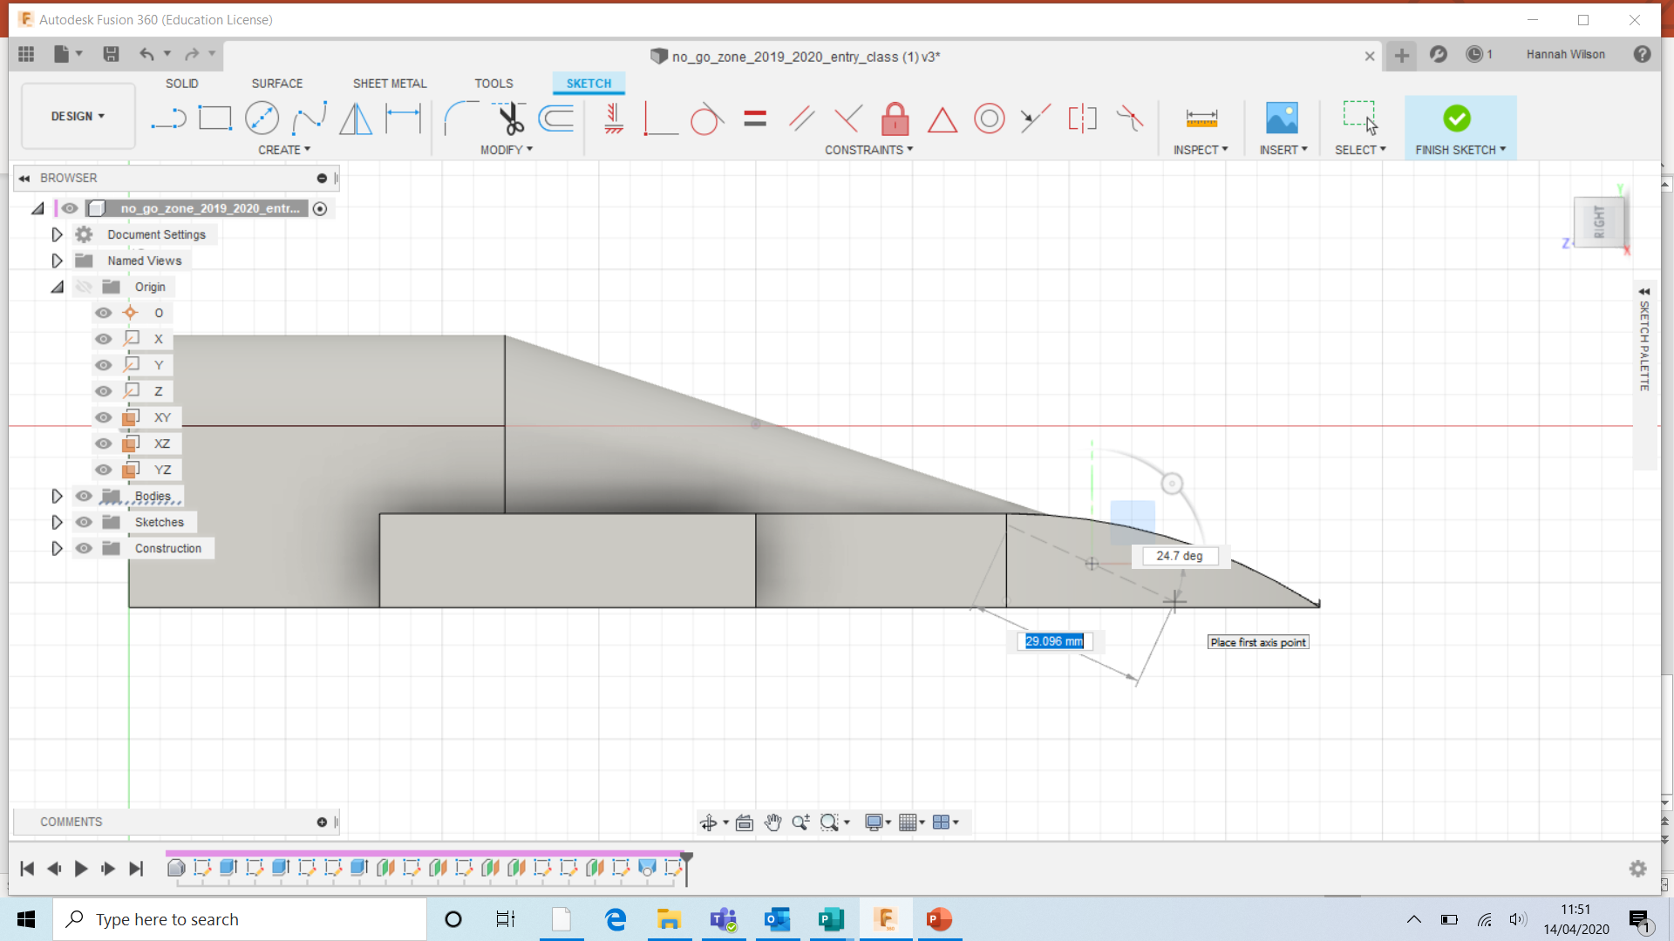
Select the place you would like the middle of the wing.
Drag the cord length of the wing.
Select the thickness of the ellipse- 3mm- 15mm

Slide 6
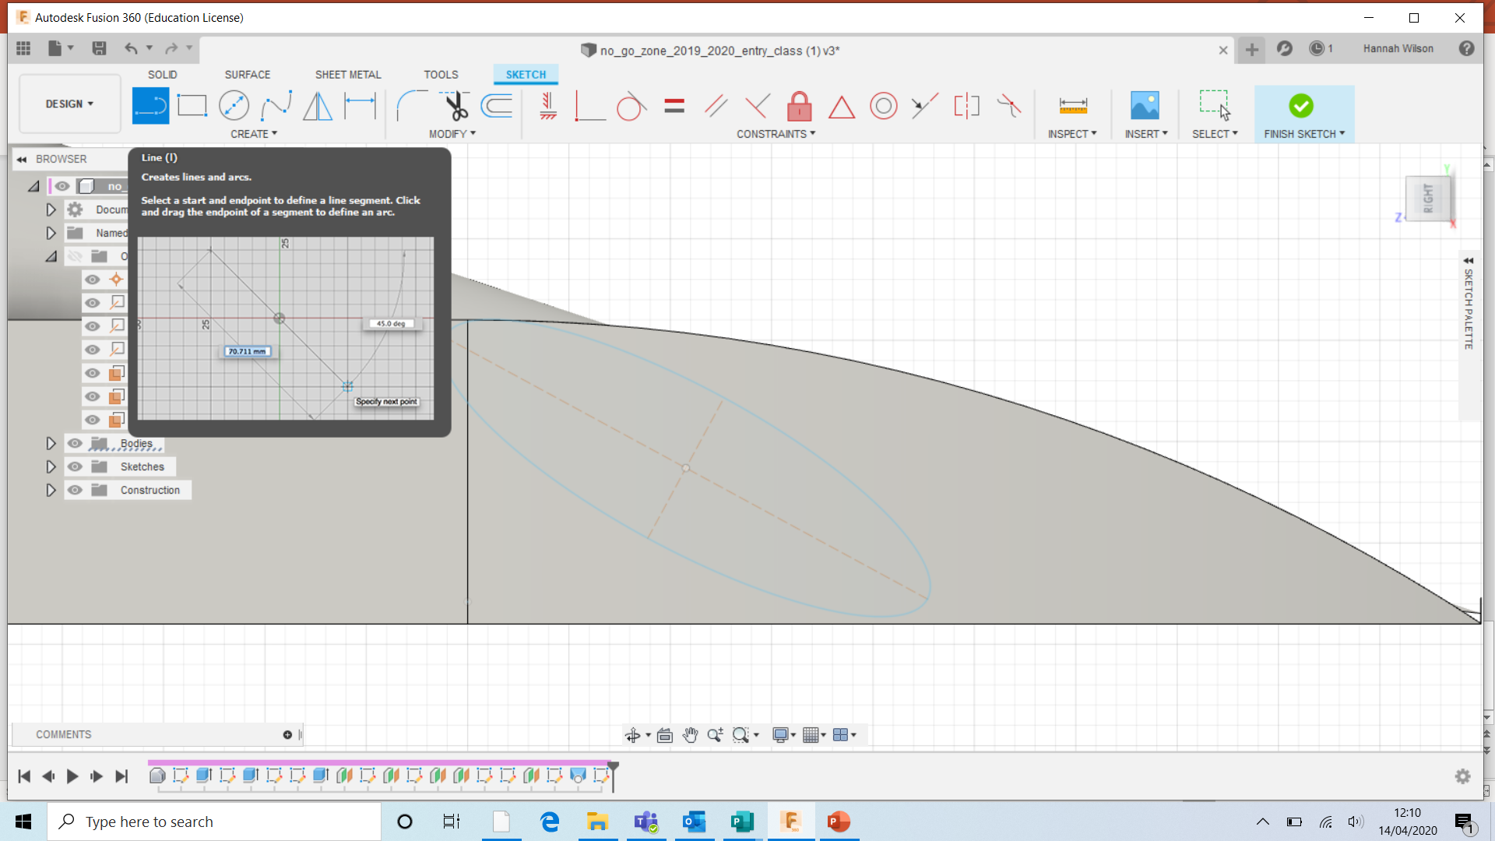
You can leave the shape as it is.
However, you can shape the ellipse to be more aerodynamic.

Slide 7
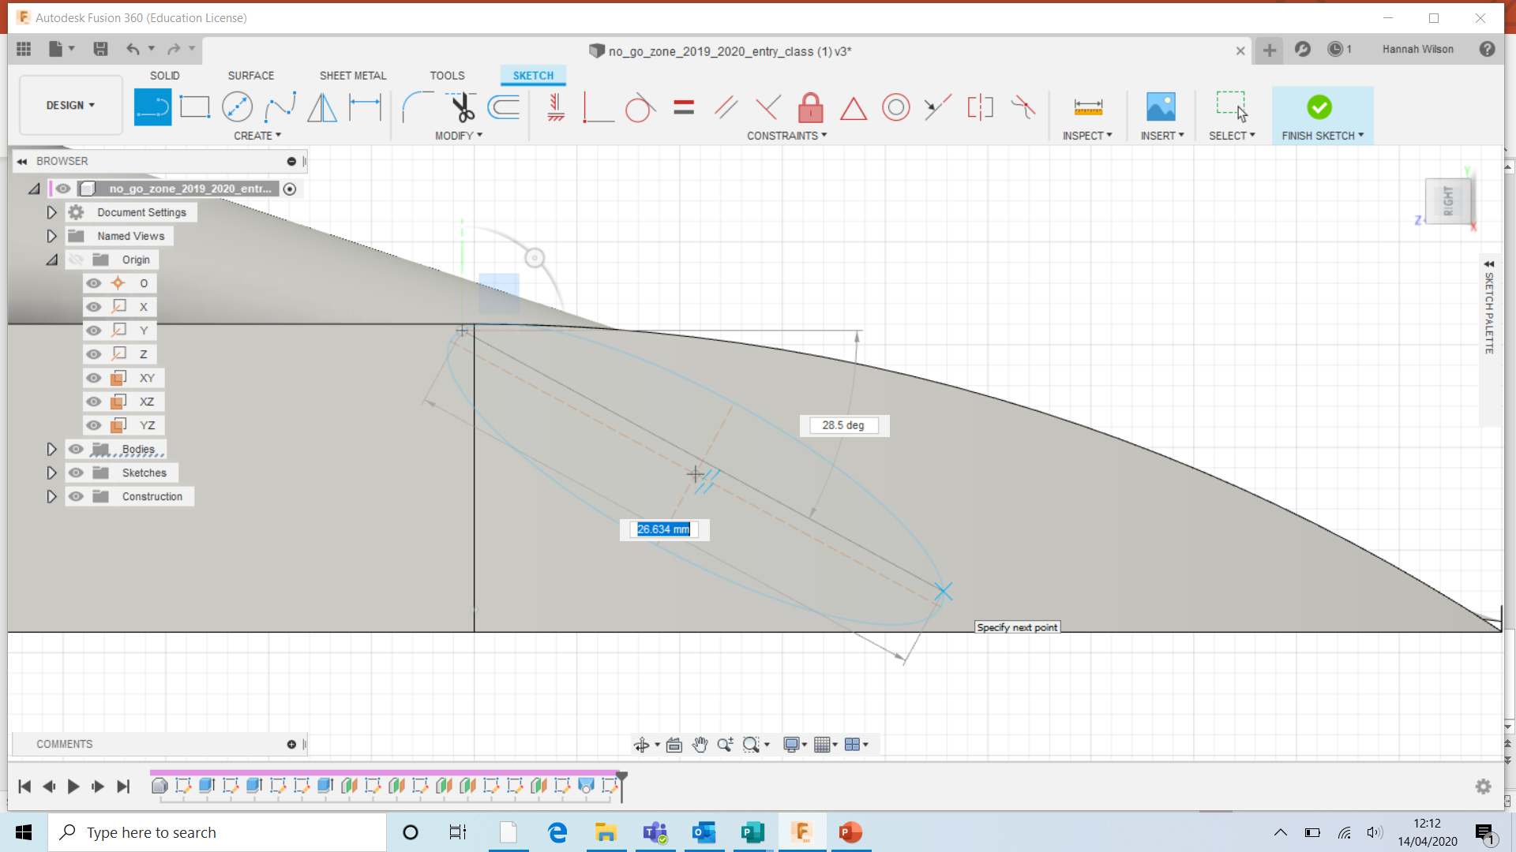
You can leave the shape as it is.
However, you can shape the ellipse to be more aerodynamic.
Select ‘LINE’- Draw the line across the ellipse.

Slide 8
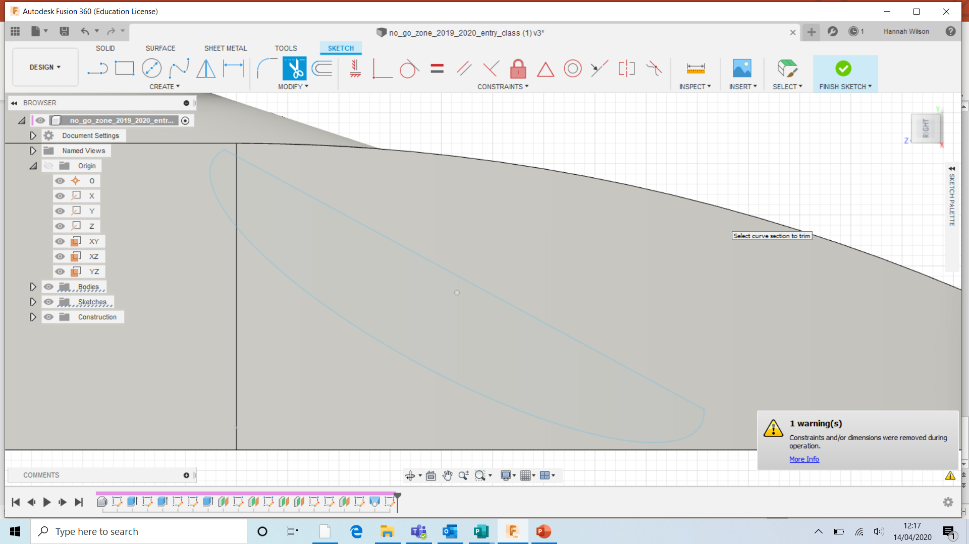
Press ‘T’ on your keyboard for the trim tool.
Select the top of the ellipse and double click.
Select ‘Finish Sketch’

Slide 9
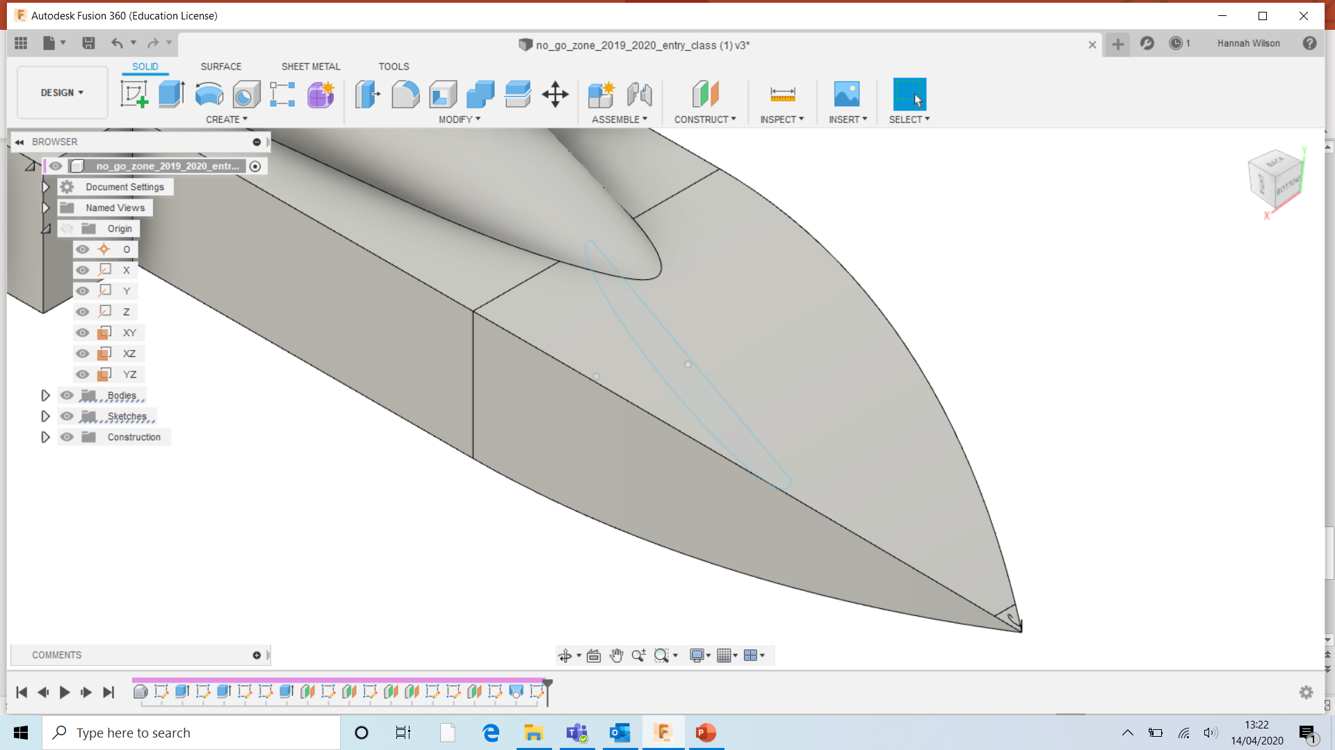

Slide 10
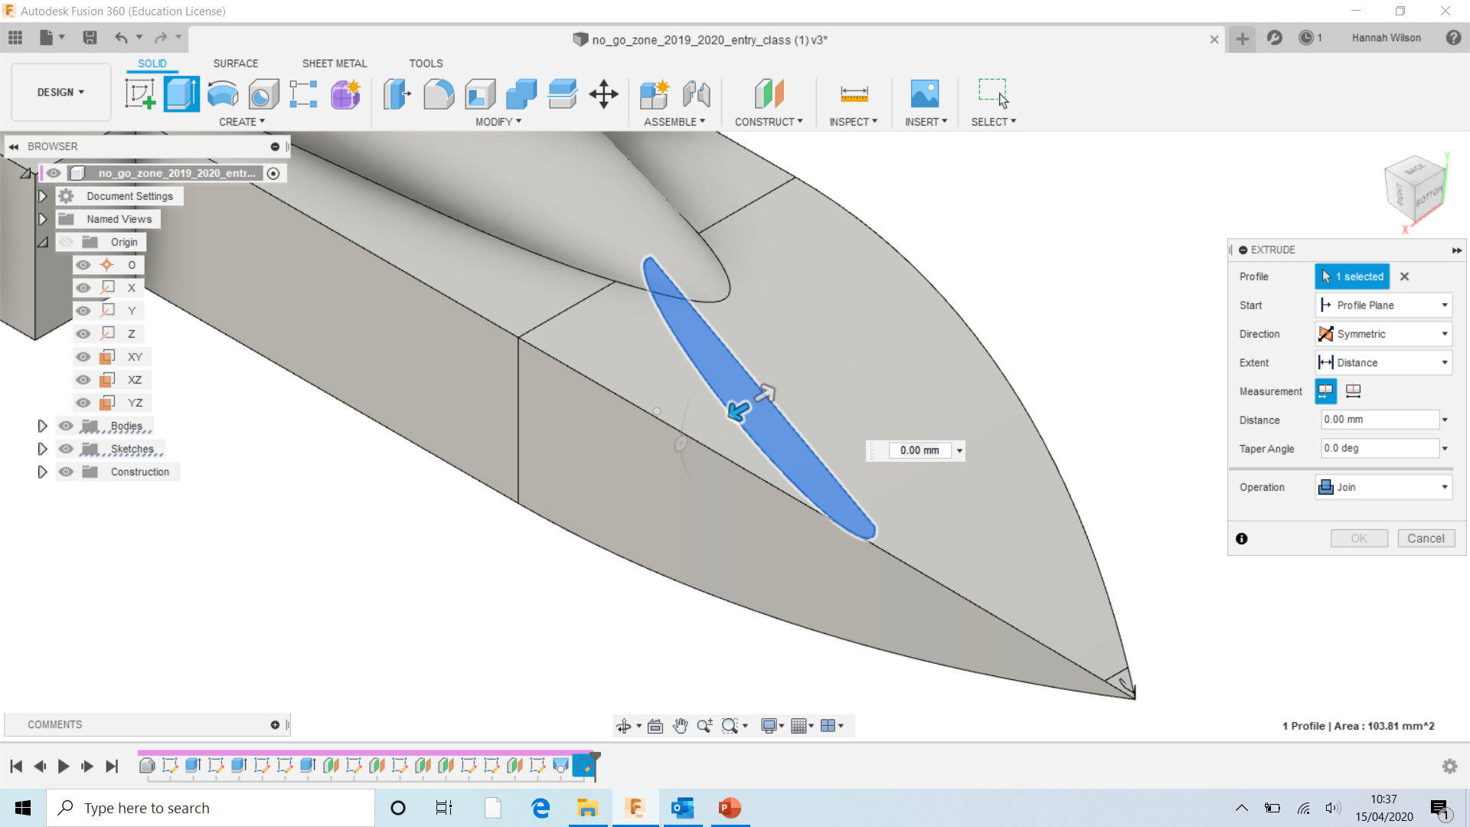
Select the shape you have created.
In the EXTRUDE menu;
Direction- Symmetric
Operation- Join

Slide 11
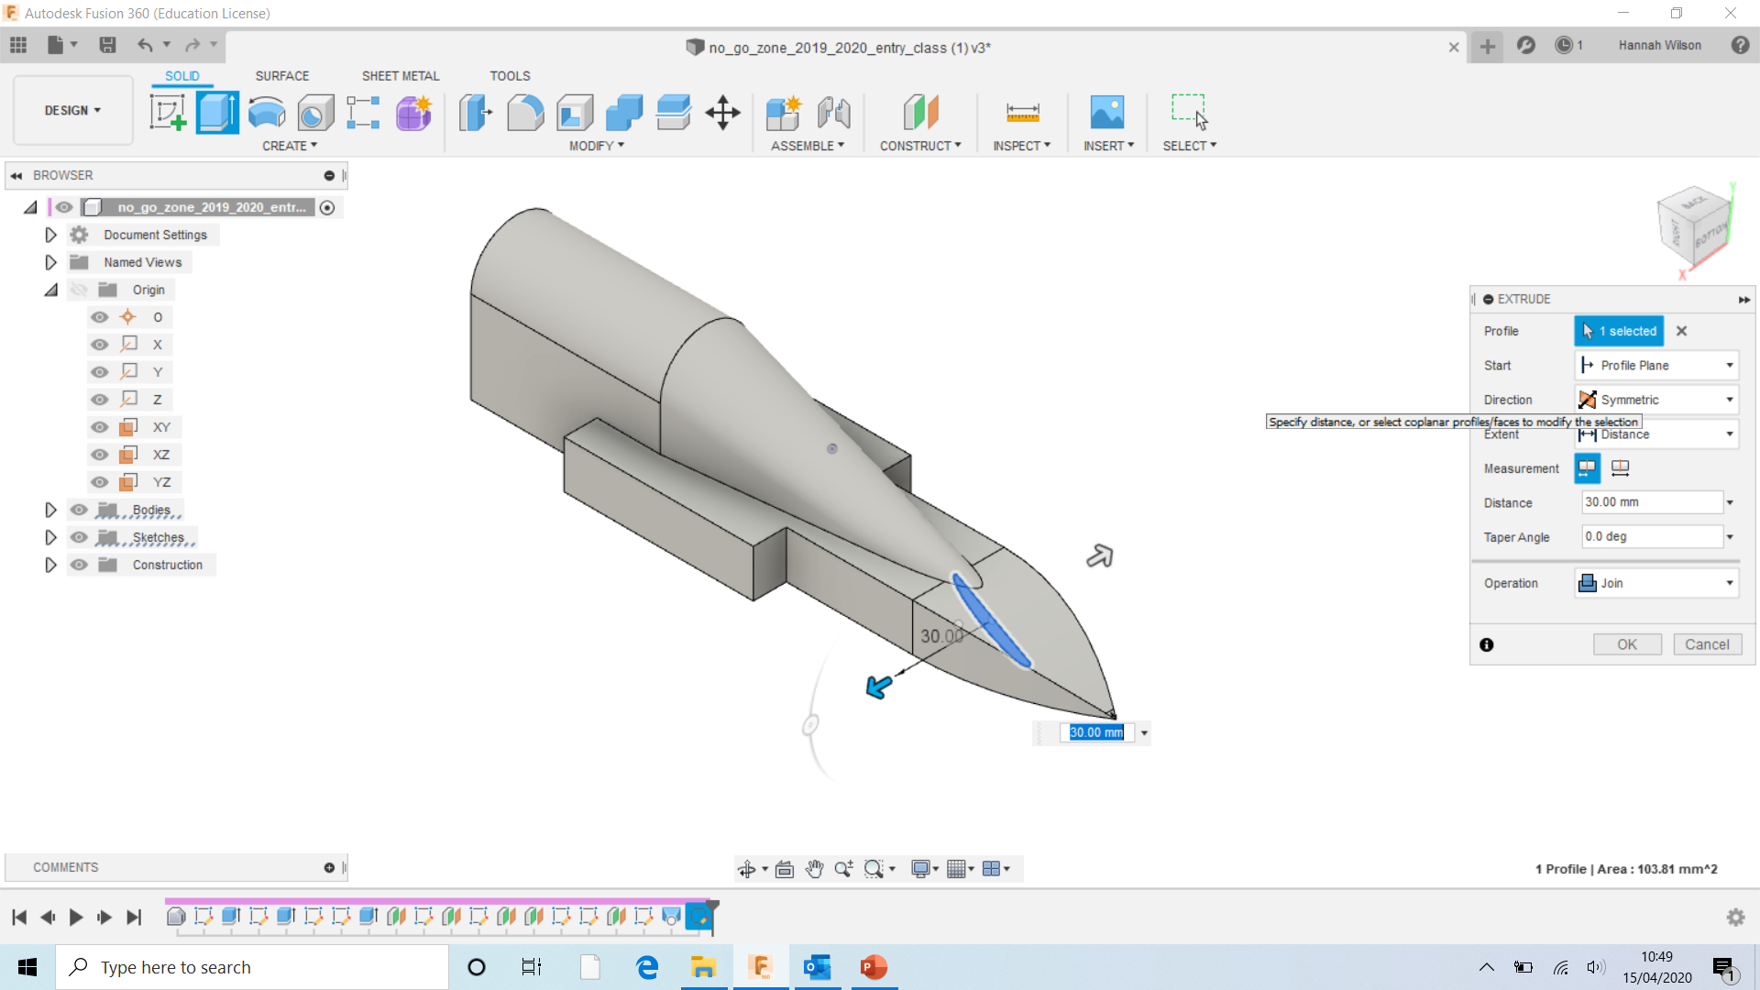
Drag the arrows outwards for the wing span.
Minimum- 60mm
Maximum- 80mm
TIP
Symmetric shows only half the measurement e.g 60mm has appeared as 30mm.

Slide 12
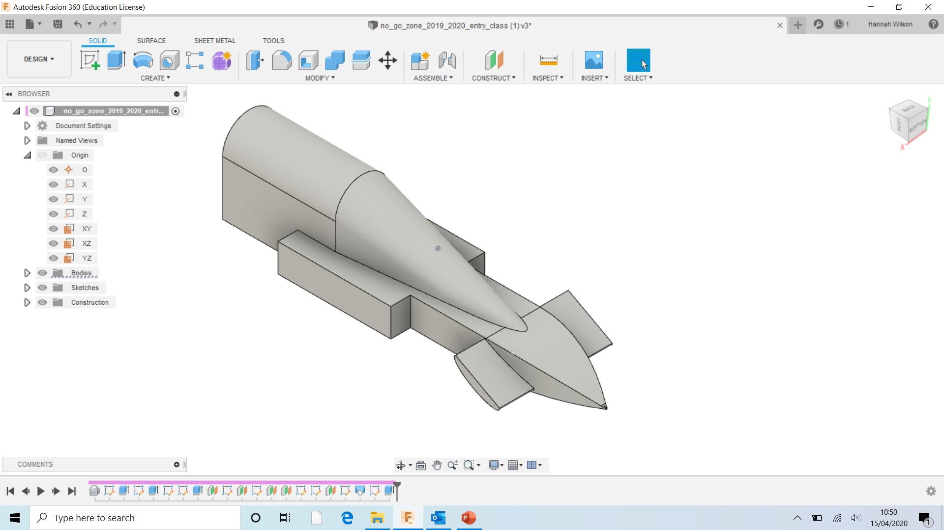
Congratulations, you have created a front wing for your car.
The next few slides show different shaped wings.

Slide 13
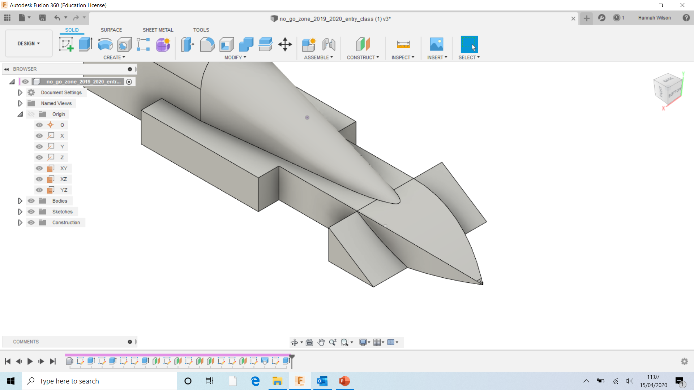
Here is another way of creating the front wings.

Slide 14
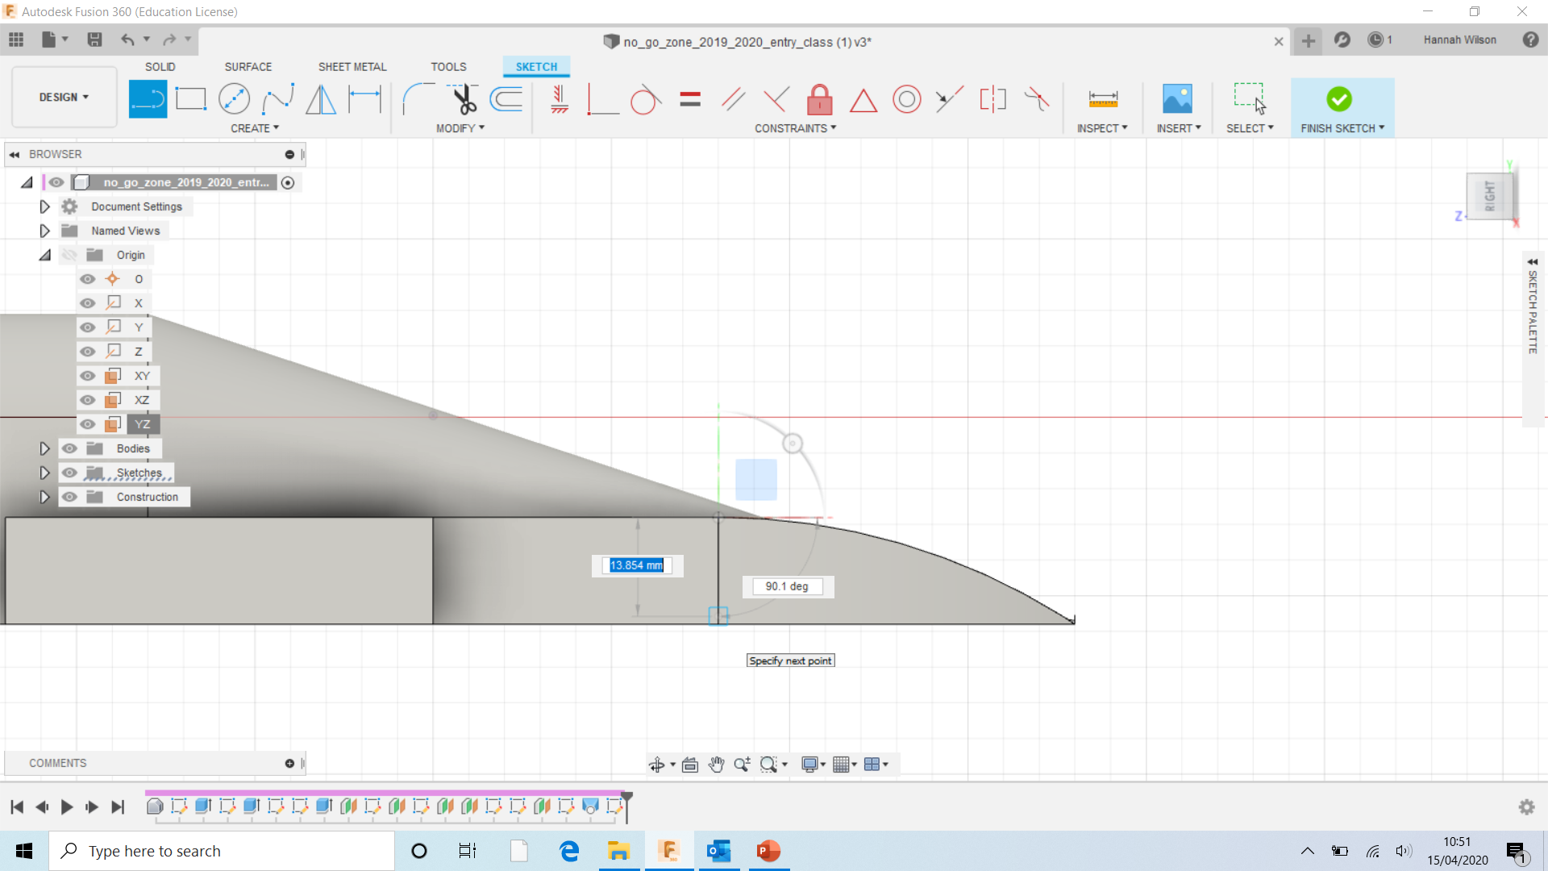
Using the line tool, create a triangle.

Slide 15
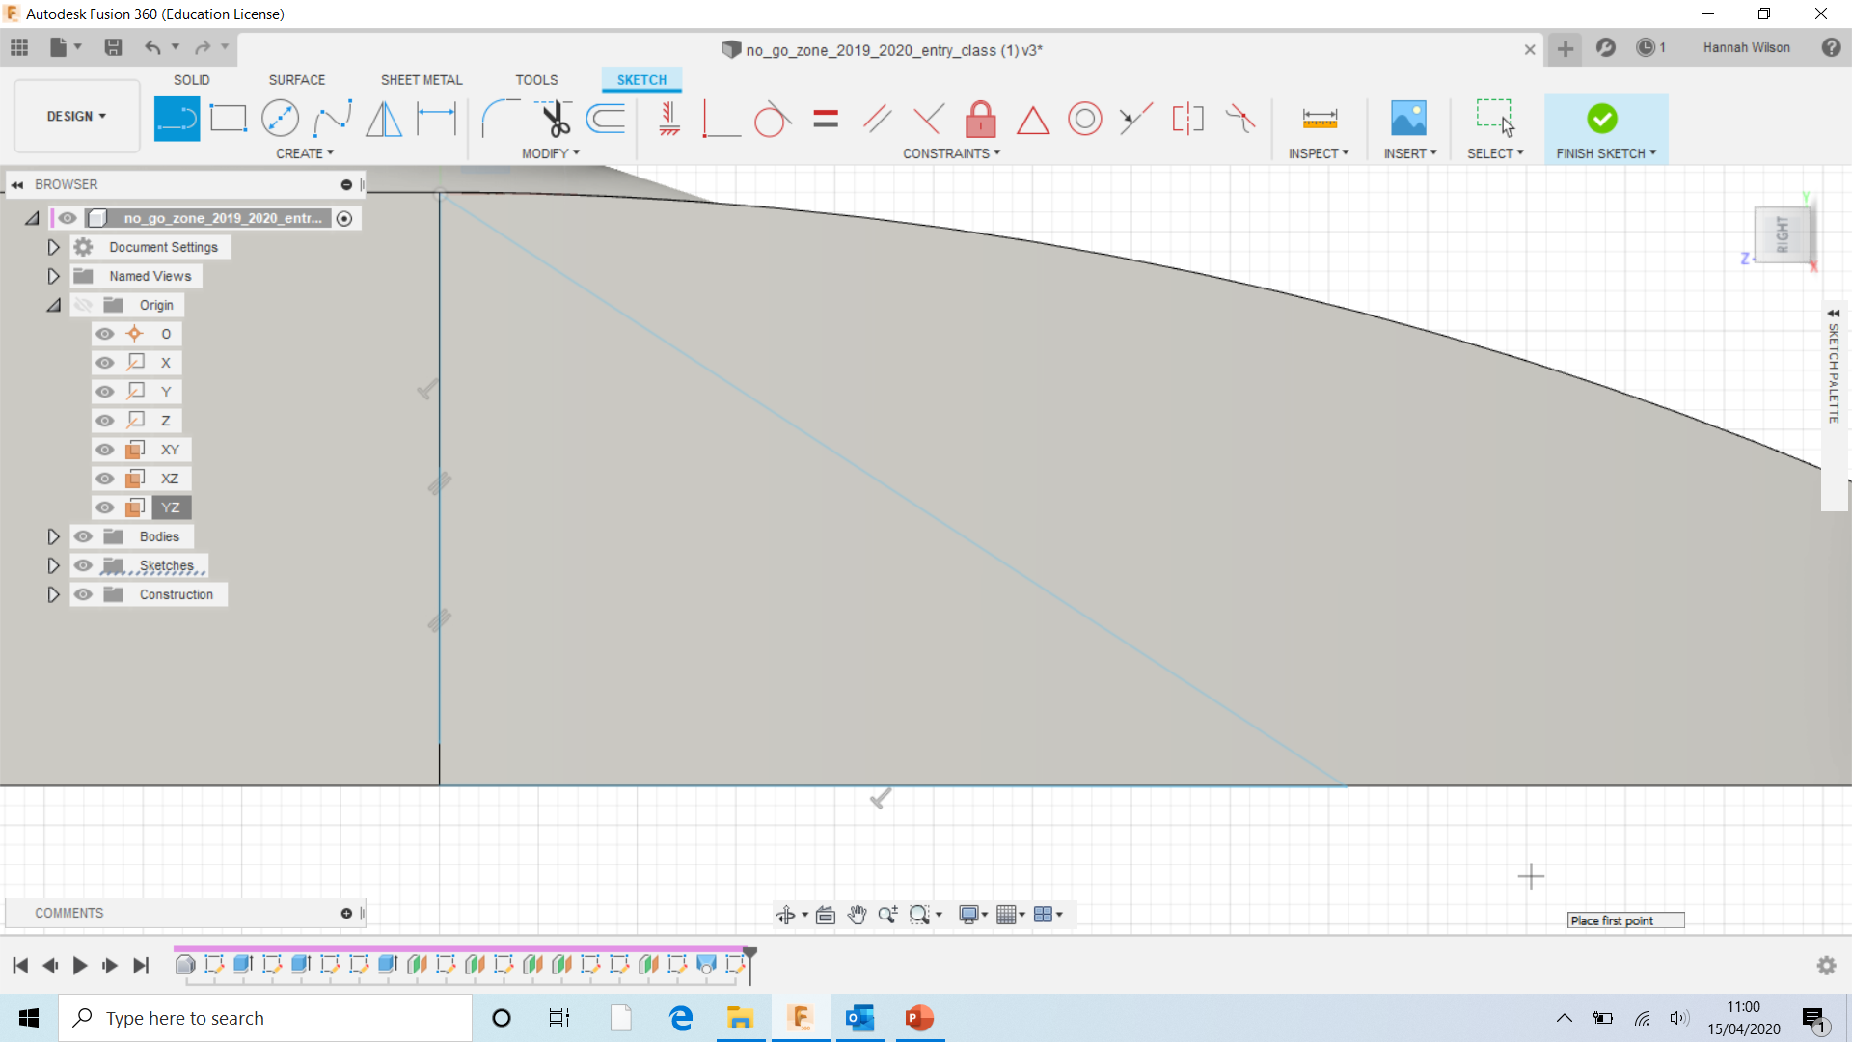

Slide 16
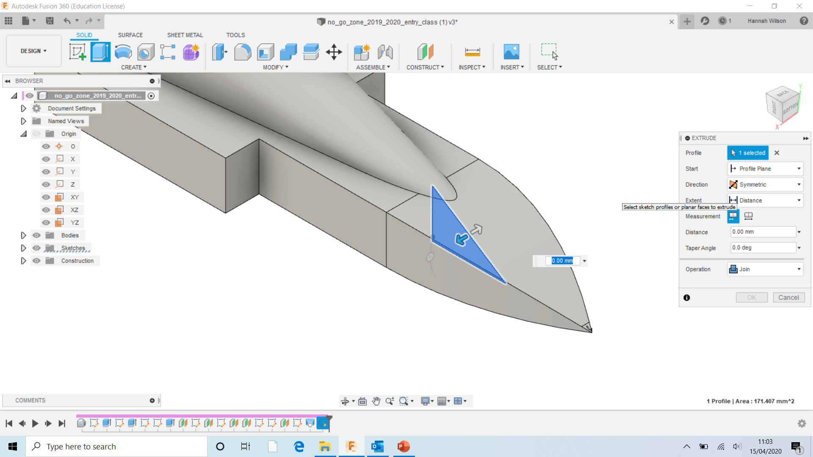
Direction- Symmetric
Operation- Join

Slide 17
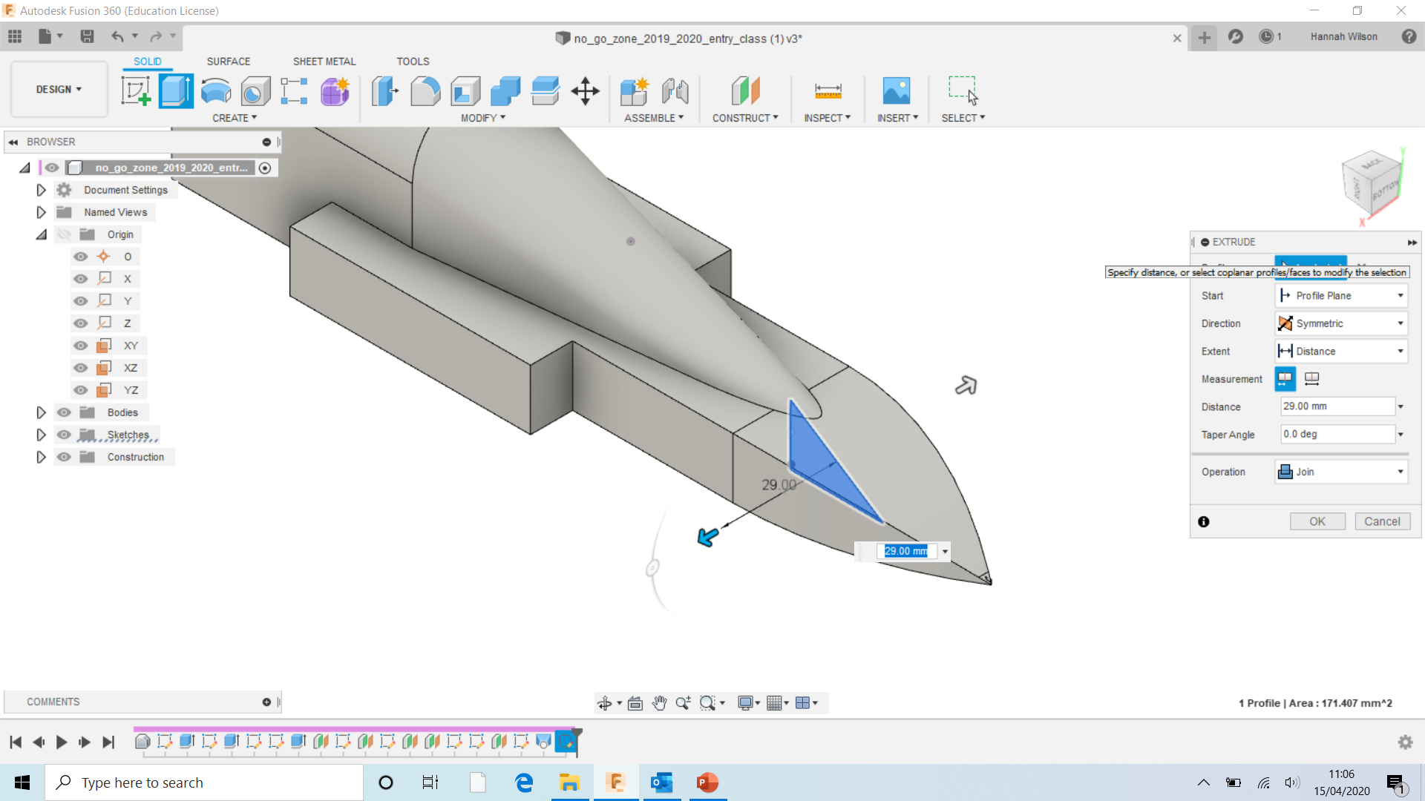
Drag the triangle out
Minimum- 60mm
Maximum- 80mm

Slide 19
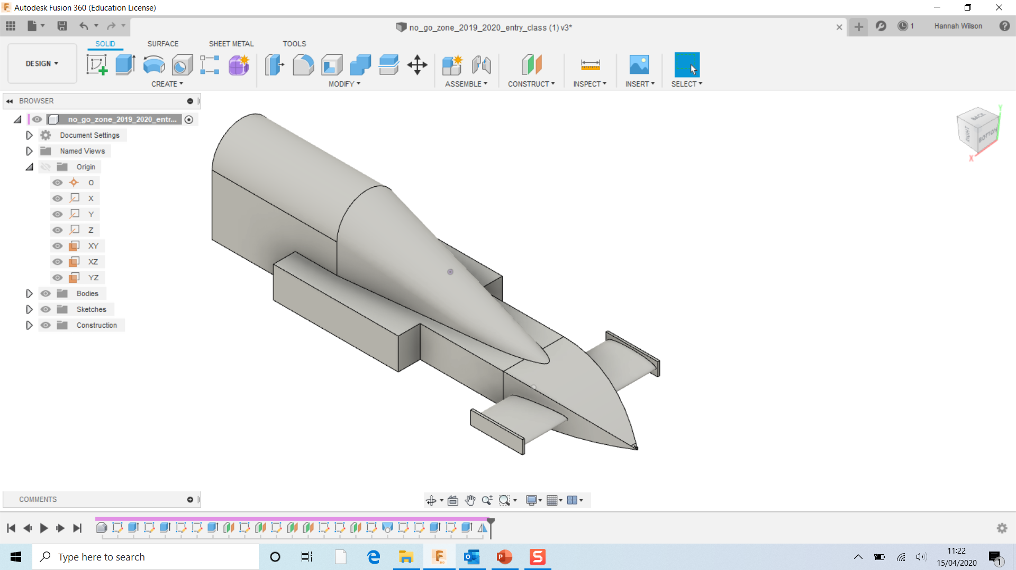

Slide 20
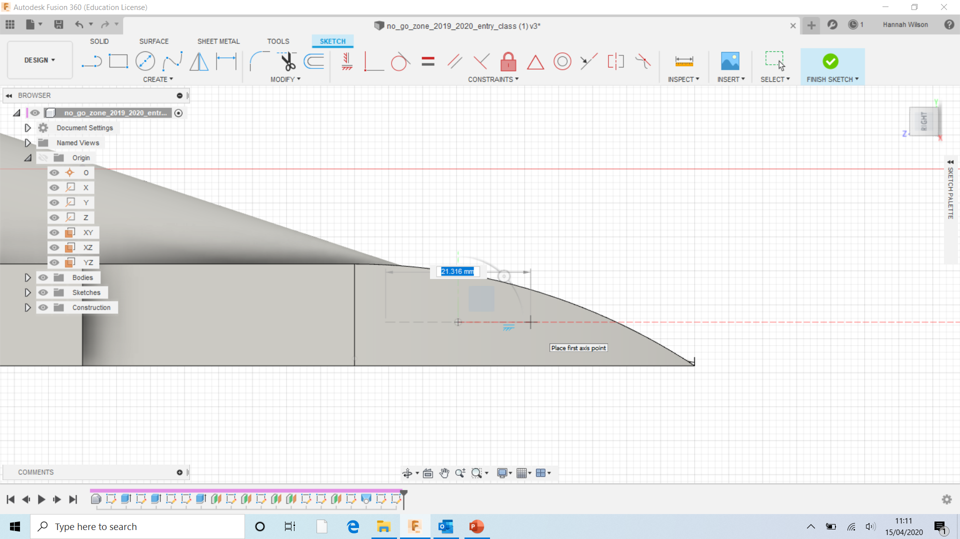
Using the ellipse tool, create an ellipse shape.

Slide 21
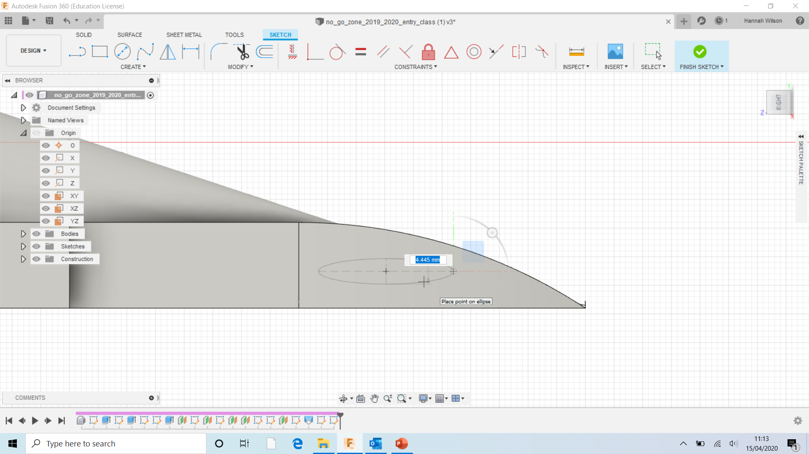

Slide 22
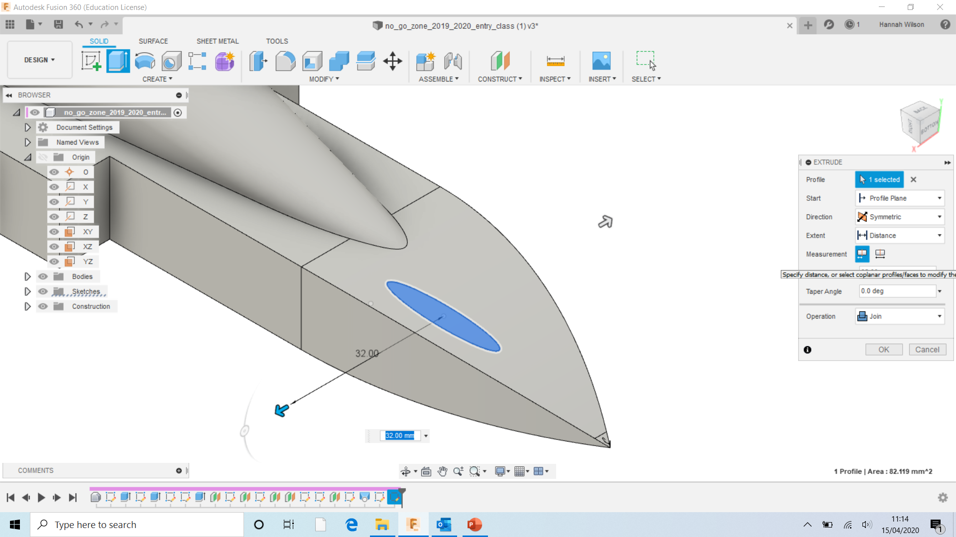
Direction- Symmetric
Operation- Join
Drag the shape out;
Minimum- 60mm
Maximum- 80mm

Slide 23
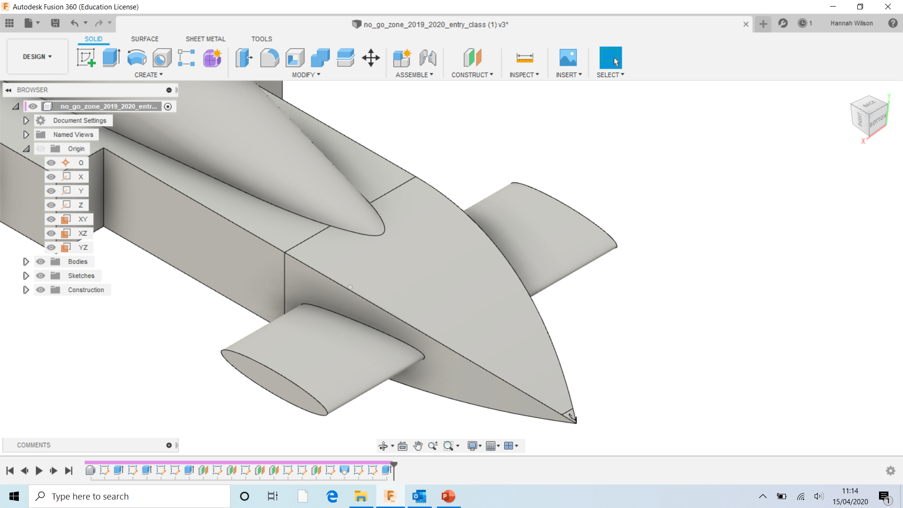

Slide 24
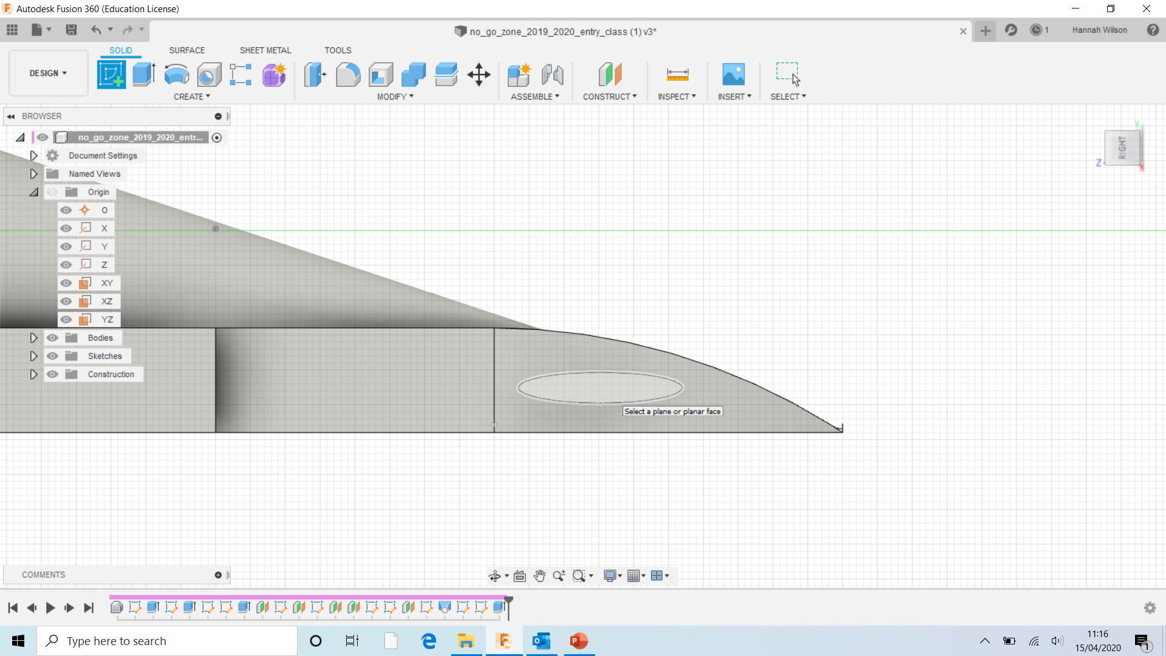
Select ‘CREATE SKETCH’
Click the end of the ellipse shape.

Slide 25
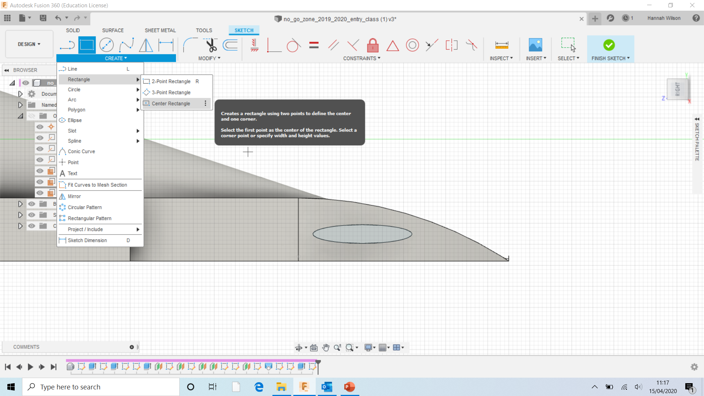
Select ‘CREATE’
Select ‘Rectangle’
Select ‘Centre Rectangle’

Slide 26
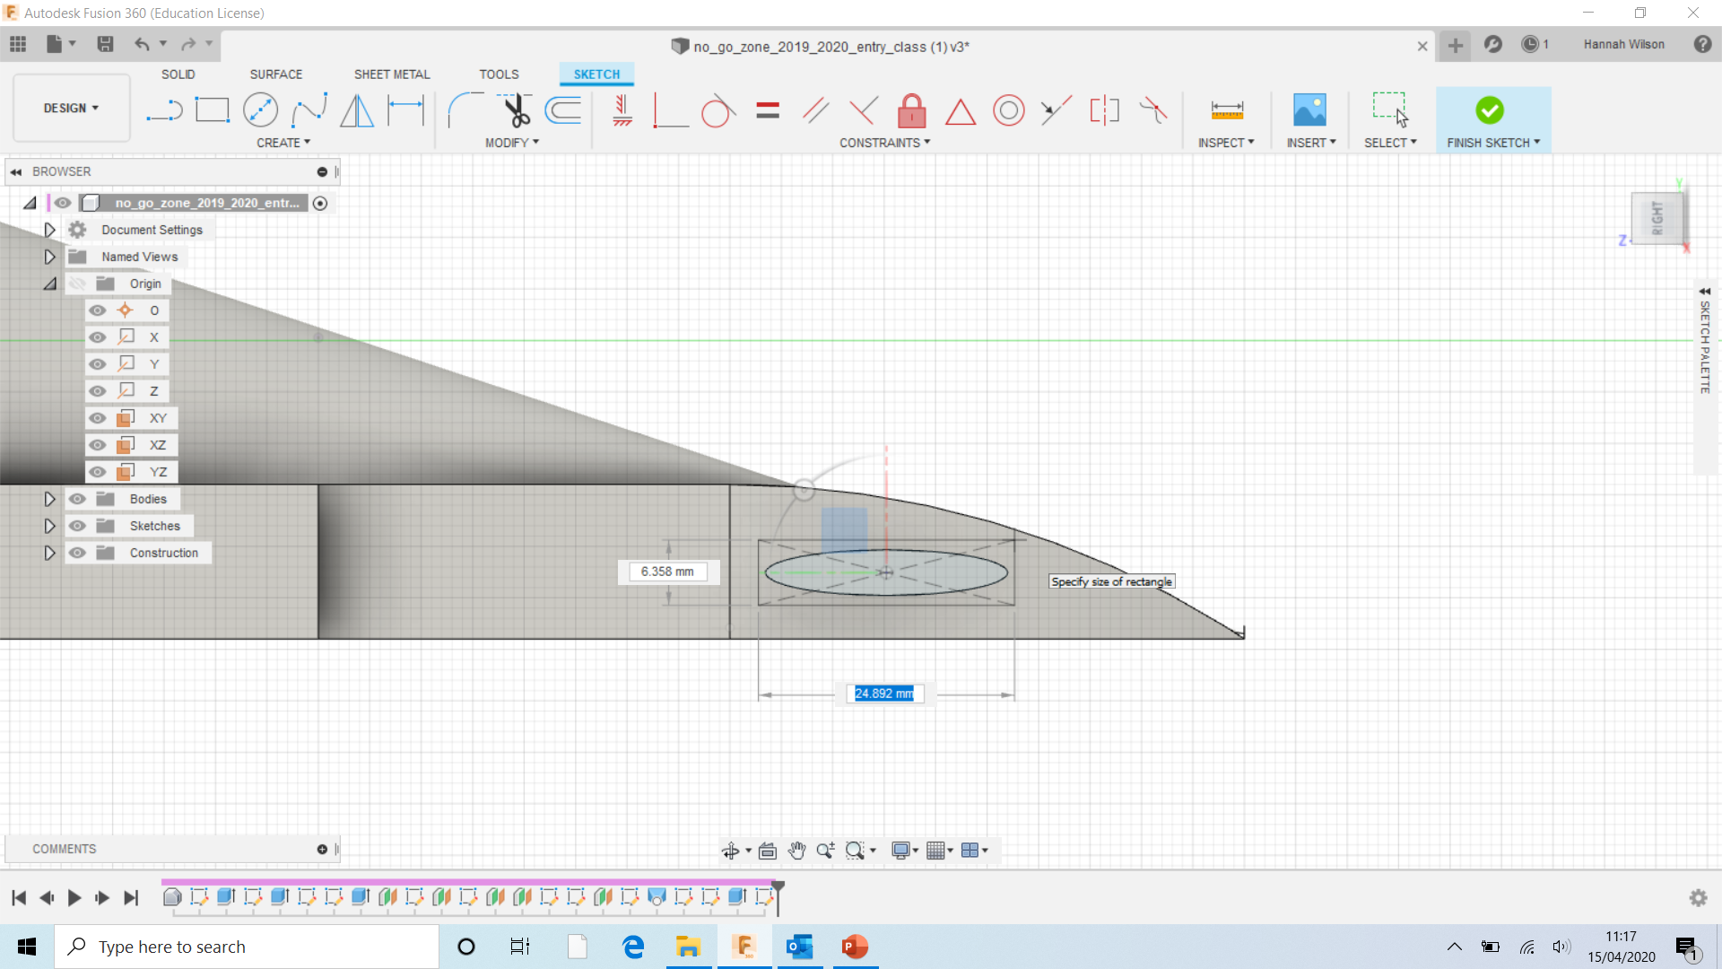
Select the middle of the ellipse.
Create a rectangle

Slide 27
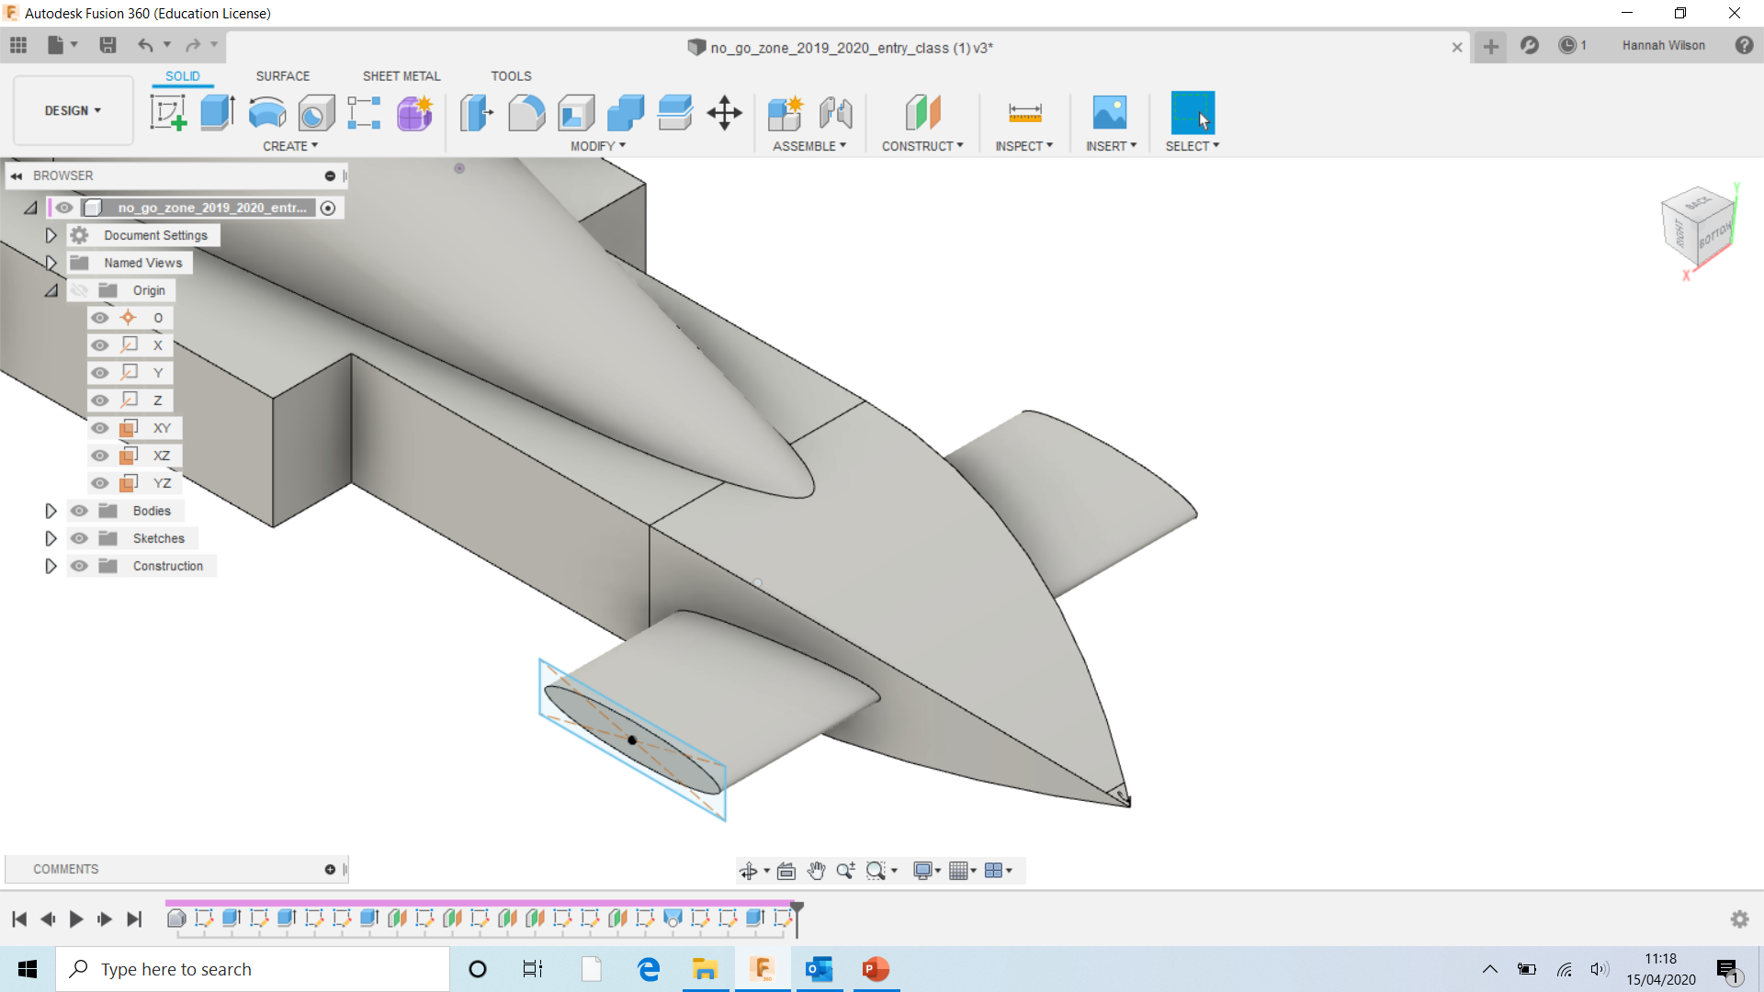

Slide 28
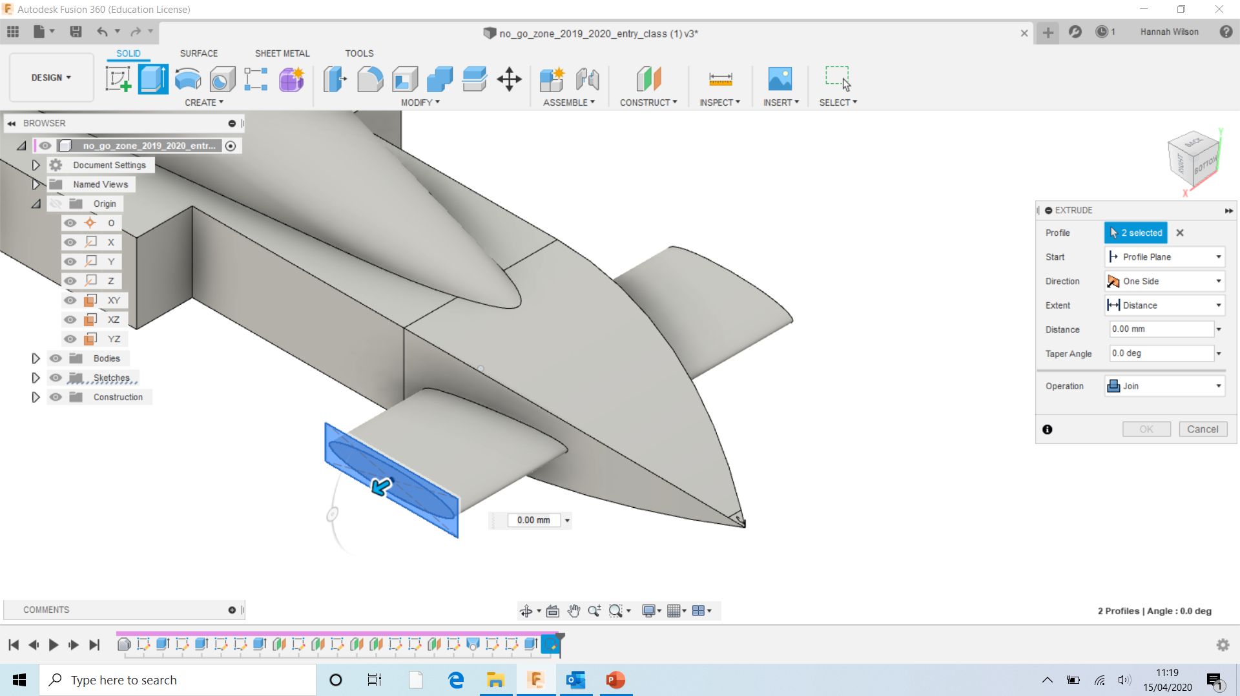
Select EXTRUDE.
Select the rectangle made.
Operation- Join

Slide 29
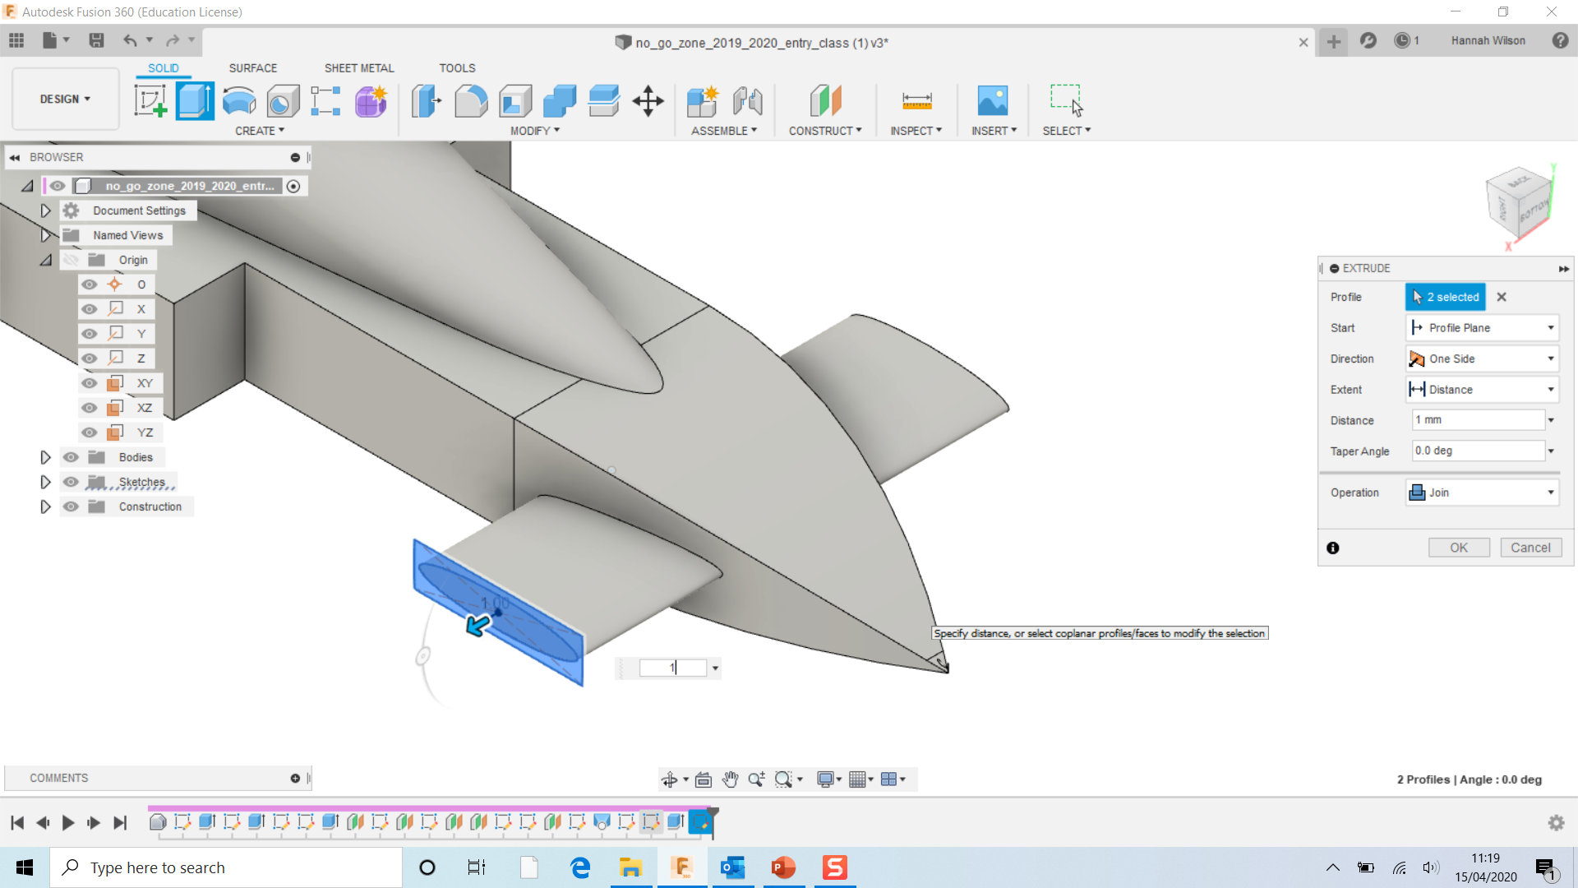
Drag the rectangle outwards.
Remember, the maximum length of the wing- 80mm

Slide 30
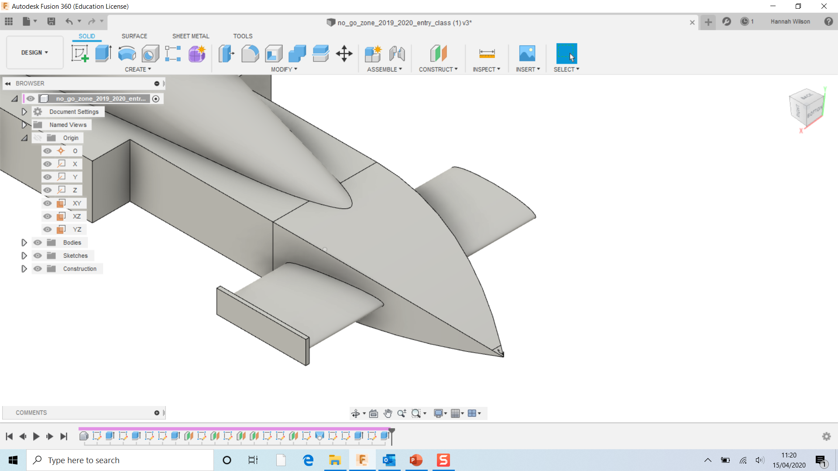

Slide 31
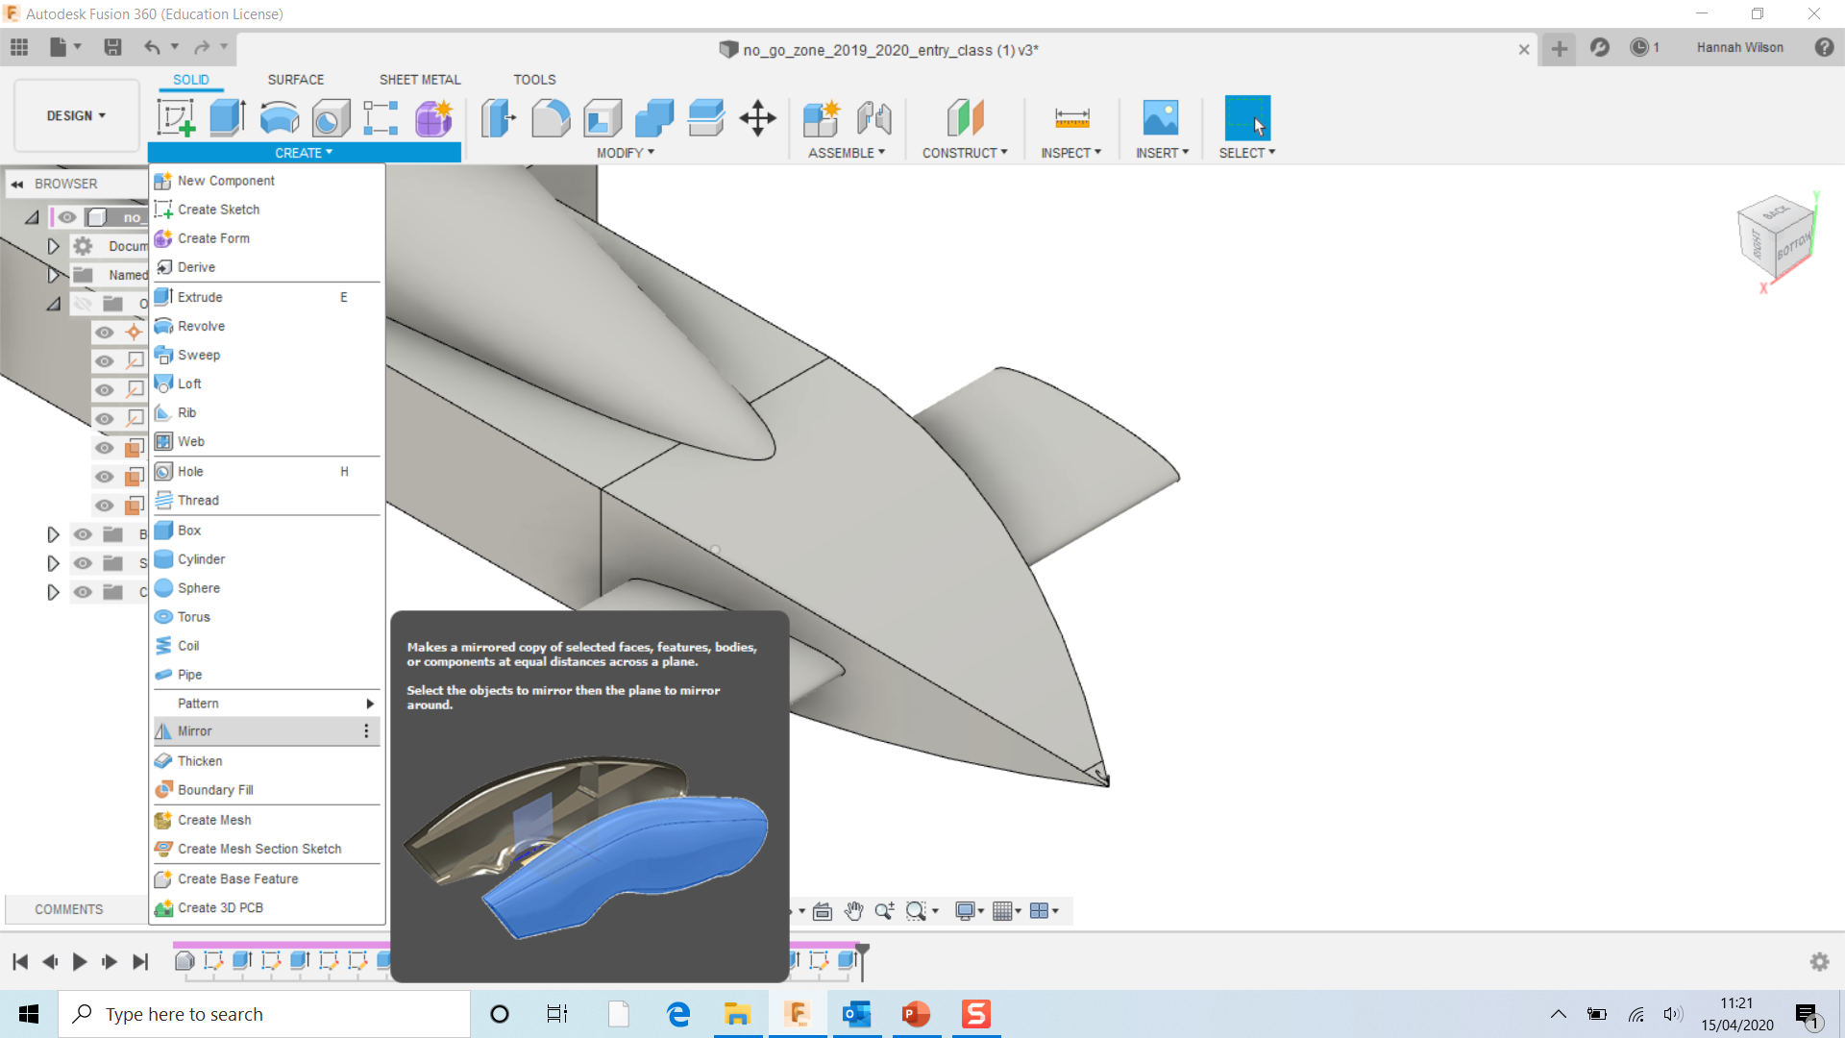
Select CREATE
Select Mirror.

Slide 32
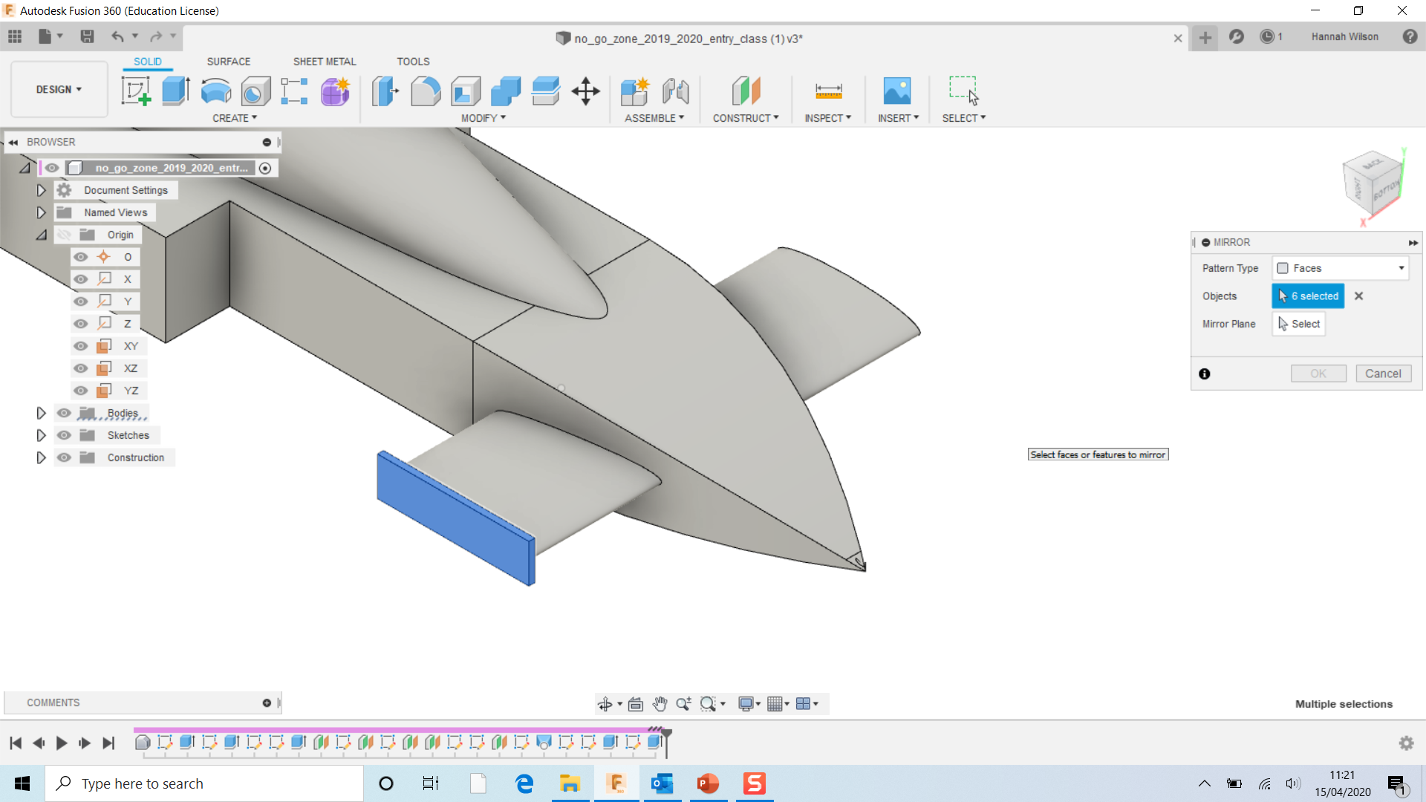
Select the rectangle you have created on the end of the ellipse.

Slide 33
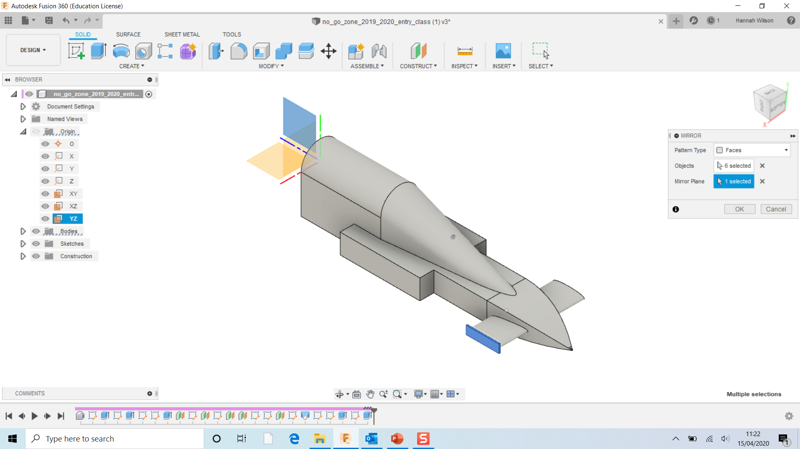
Select Mirror Plane in the MIRROR menu
Select the middle plane
Click OK

